Slide 1
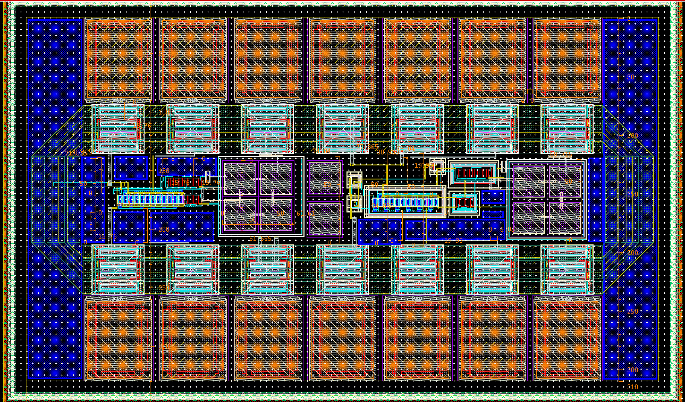
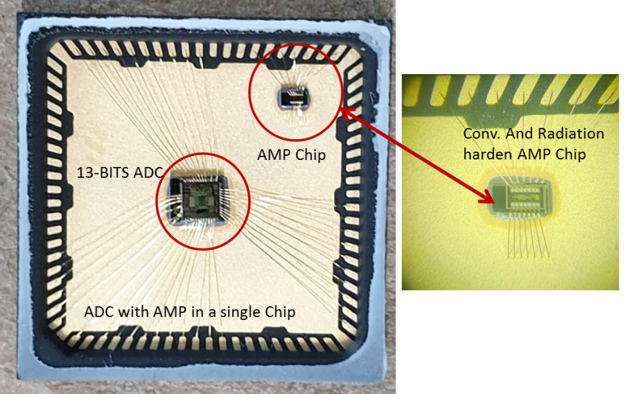
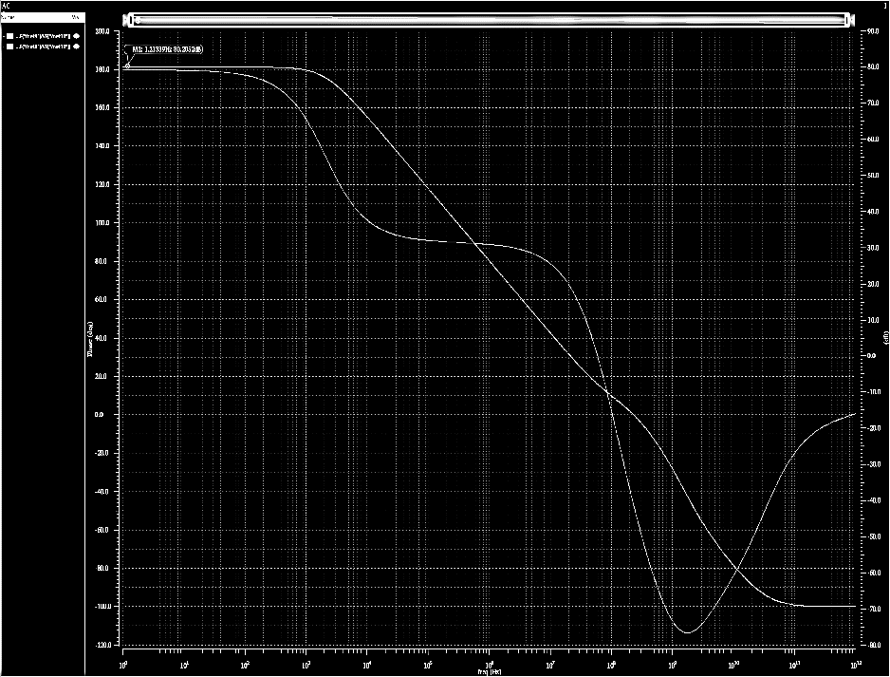
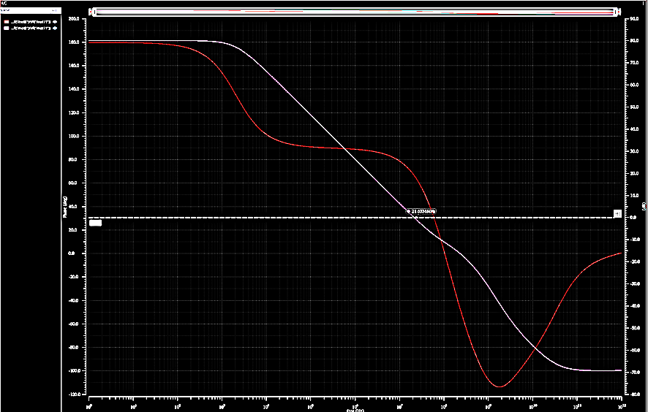
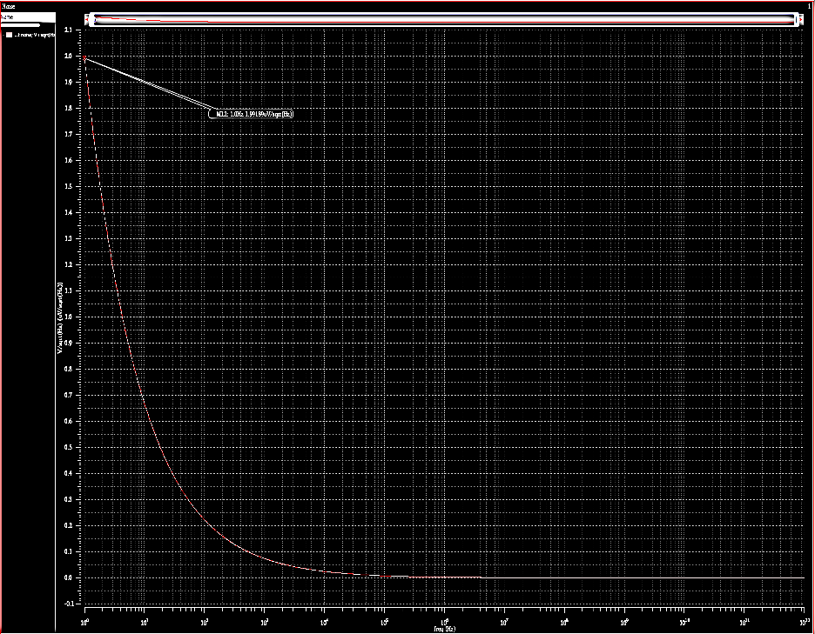
Radiation-hardened-by-design (RHBD)
Pre-amplifier design for Radiation Harsh Environment
Waseem Muhammadª, Byeongjae Yuª, Minuk Seung^{b}, Inyong Kwon^{b}, and Jung-Yeol Yeom*^{a,c}
ª Department of Bio-convergence Engineering, Korea University, Seoul, Korea
^{b} Korea Atomic Energy Research Institute, Daejeon, Korea
^{c} School of Biomedical Engineering, Korea University, Seoul, Korea
*E-mail: jungyeol@korea.ac.kr
Introduction
Results and Discussion
Radiation effects on electronics
Single Event Transient (SET)
Single Event Upsets (SEU)
Single Event Latch-up (SEL)
Total Ionizing Dose effects (TID) etc.
Radiation-hardened-by-design (RHBD)
Techniques to minimize the impact of radiation in circuits under high radiation environments such as nuclear power plants or outer space
Radiation hardening by physical modification
Silicon on insulator (SOI), enclosed layout transistor (ELT), etc.
Radiation hardening by logical modification
Triple modular redundancy (TMR), error detection and correction (EDAC)
Aim of this work
Developing a RHBD pre-amplifier architecture with high gain and maximum swing that is immune to radiation impact events in high radiation environments.
Simulation Results
The amplifier design was carried out in standard 0.18 um CMOS technology with a 1.8 V supply voltage and 73μA current as biasing.
The voltage gain of 80.2 dB and 21.6 MHz unity gain bandwidth was achieved.
Common Mode Rejection Ratio (CMRR) was measured 70.3 dB while Power supply Rejection Ration (PSRR) was 83.8 dB and 74.0dB for PSRR+ and PSRR- respectively.
Total Power consumption of pre-amplifier was 9.8 mW
VSS
VINP
VOUT
VSS2
VSS2
VINP2
VOUT2
Normal
With GR
Chip Design Overview
IREF
VINN
VDD
IREF2
VSS2
VINN2
VDD2
Method
In order to achieve high gain and large output swing, the amplifier consists of two stages. The first stage gives the high gain, while the second stage provides large output swing.
The first stage consists of differential input n-channel transistors M2 and M3 with current mirror load p-channel transistors M0 and M1. The second stage consists of p-channel common source amplifier M6 with n-channel current source M5.
The input bias current IREF is mirrored in M7, M4, and M5, so that the same current with the IREF goes through each transistor to operate in saturation region.
The Capacitor C0 is miller cap to separate two poles for securing phase margin
Fig. 2. . Layout Design With/Without Guard Ring Regulated Cascode Amplifier.
Parameter | Value | Unit
Supply Voltage | 3.3 | V
Supply Current | 73 | uA
DC Gain | 80.2 | dB
Unity Gain Bandwidth | 21.6 | MHz
-3 dB Bandwidth | 2.05 | kHz
Phase Margin | 66.3 | deg
Gain Margin | 11.1 | dB
Common Mode Rejection Ratio | 70.3 | dB
Power Supply Rejection Ratio (Positive) | 83.8 | dB
Power Supply Rejection Ratio (Negative) | 74.0 | dB
Slew Rate (rising) | 24.8
Input Referred Noise | 1.99
13-BITS ADC and Amplifier
Table. 1. Simulation Results Summary
VDD
Fig. 3. Internal view of fabricated Chip of With/Without Guard Ring Regulated Cascode Amplifiers. The chip also contains analog to digital converter (ADC).
M1
M0
M6
IREF
VINP
M3
M2
VINN
C0
VOUT
M7
M4
M5
A
B
C
GND
Fig. 4. Simulation results of pre-amplifier. Voltage gain and phase margin (A), Unity gain bandwidth (B) and Input referred noise (C)cof the amplifier.
Fig. 1. Schematic Design for Two-stage Regulated Cascode Amplifier .
Conclusion
Radiation-hardened-by-design (RHBD) Layout Design and Fabrication
We have implemented RHBD technique using Guard Ring, compatible with standard circuit processes for electronics in harsh radiation conditions.
The chip design has been fabricated and will be measured in high radiation environments.
The Layout technique is based on the use of guard rings to shield amplifier circuit.
Two types of guard rings were used:
isolation guard ring is used to eliminate the inter-transistor leakage generated by the substrate inversion below the field oxide.
charge drain guard ring is responsible for collecting free charges on the substrate.
Monte-Carlo simulations, particularly for amplifier, was performed and granted the circuit for process, voltage, and temperature (PVT) variations.
Finally, top-level verification including parasitic extraction was carried out after LVS, DRC for the entire design.
The chip area of the customized conventional and RHBD pre-amplifier was 350μm x 580μm
Acknowledgement
The chip fabrication and EDA tool were supported by the IC Design Education Center (IDEC), Korea, and This work was supported in part by National Research Foundation (NRF) of Korea (2020R1A2C2007376 and 2020M2A8A4023713)
Reference :
[1] Baker, R. Jacob. CMOS: circuit design, layout, and simulation. John Wiley & Sons, 2019.
[2] Knoll, Glenn F. Radiation detection and measurement. John Wiley & Sons, 2010..
[3] Hastings, Alan. The an of analog layout. New Jersey: Prentice hall, 2001.
[4] Hogervorst, Ron, and Johan Huijsing. Design of low-voltage, low-power operational amplifier cells. Vol. 374. Springer Science & Business Media, 2013.

